Slide 1
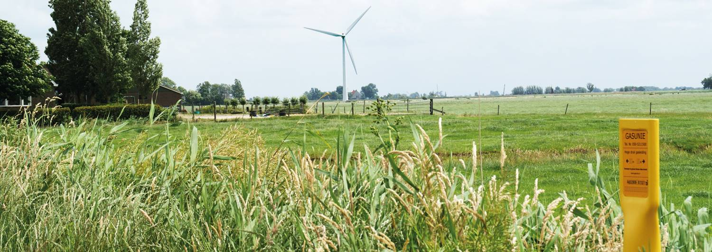
Consultation of the planning assumptions to determine the required Groningen production
Planning assumptions for gas year 2022/2023

Slide 2
Content
Legal framework
Evaluation gas year 2020/2021
Adjusted Gas Act and (recap) methodology
Planning assumptions for gas year 2022/2023
Consultation process
Changed assumptions for current gas year

Slide 3
Content
Legal framework
Evaluation gas year 2020/2021
Adjusted Gas Act and (recap) methodology
Planning assumptions for gas year 2022/2023
Consultation process
Changed assumptions for current gas year

Slide 4
Legal framework
GTS has to perform its legal tasks in such a way that this contributes optimally to minimize the production from the Groningen field.
  Evaluation: After each gas year GTS has to report to the Minister of Economic Affairs and Climate Policy (MEZK) how this has been done
GTS has the legal obligation to advice MEZK regarding the required Groningen production (capacity, volume) for the next ten gas years before 1st February of each year
  Planning assumptions are the basis for this advice
Finally, during a gas year, GTS must report significant deviations in the availability of the relevant blending facilities and the gas market, which could affect the required Groningen production
Foreseen adjustment of Gas Act: “Wat na nul”

Slide 5
Content
Legal framework
Evaluation gas year 2020/2021
Adjusted Gas Act and (recap) methodology
Planning assumptions for gas year 2022/2023
Consultation process
Changed assumptions for current gas year

Slide 6
Evaluation gas year 2020/2021
Realised number of degree days: 2261 (average winter)
Calculated and realized L-gas market 47.4 bcm
Calculated and realized Groningen production 7.8 bcm
Average realized nitrogen utilization 100%
GTS has produced 39.3 bcm pseudo G/L-gas via enrichment and nitrogen blending
Modelled Wobbe-index slightly higher than realised Wobbe-index: Realised 51.64 MJ/m³ and modelled 51.9 MJ/m³
Storages (seasonal and caverns) are almost volume neutral
No back-up volume needed
The report shows that GTS performed its legal tasks in such a way, that an optimal contribution was made to minimize the production from the Groningen field with existing means and methods.
  https://www.gasunietransportservices.nl/en/news/decrease-groningen-field-production-according-planning-some-delivery-zuidbroek

Slide 7
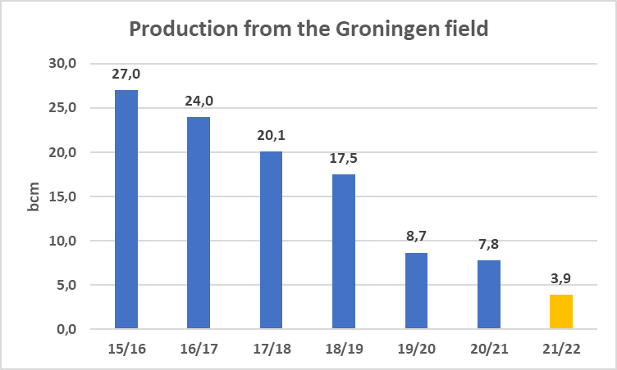
Production from the Groningen field
21/22: from “vaststellingsbesluit” for average winter
https://www.rijksoverheid.nl/documenten/rapporten/2021/09/24/vaststellingsbesluit-groningen-gasveld-2021-2022

Slide 8
Content
Legal framework
Evaluation gas year 2020/2021
Adjusted Gas Act and (recap) methodology
Planning assumptions for gas year 2022/2023
Consultation process
Changed assumptions for current gas year

Slide 9
Gas act changes: “Wat na nul”
General remark GTS: Well functioning gas market must be maintained, so security of supply and quality neutral market are crucial prerequisites
  Serious attention needed for security of supply due to closure of the Groningen field
'Wat na Nul’: consultation version of changes in Gas Act
  To ensure that the situation in the final period of deployment and after the closure of the Groningen field is properly regulated
Work in progress
Phase I: Groningen at minimum flow
  Groningen production in case of cold days
  Groningen production in case of pseudo G-gas production limitations: back-up volume
  Minimum flow production determined based on rules provided by MEZK
Phase II: Groningen flow zero
  Special attention to safety and remaining obligations of NAM.

Slide 10
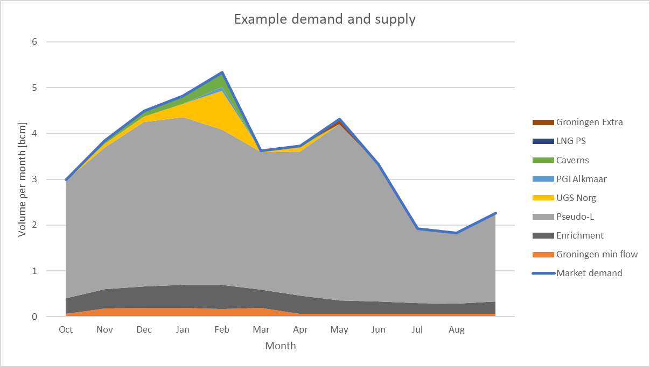
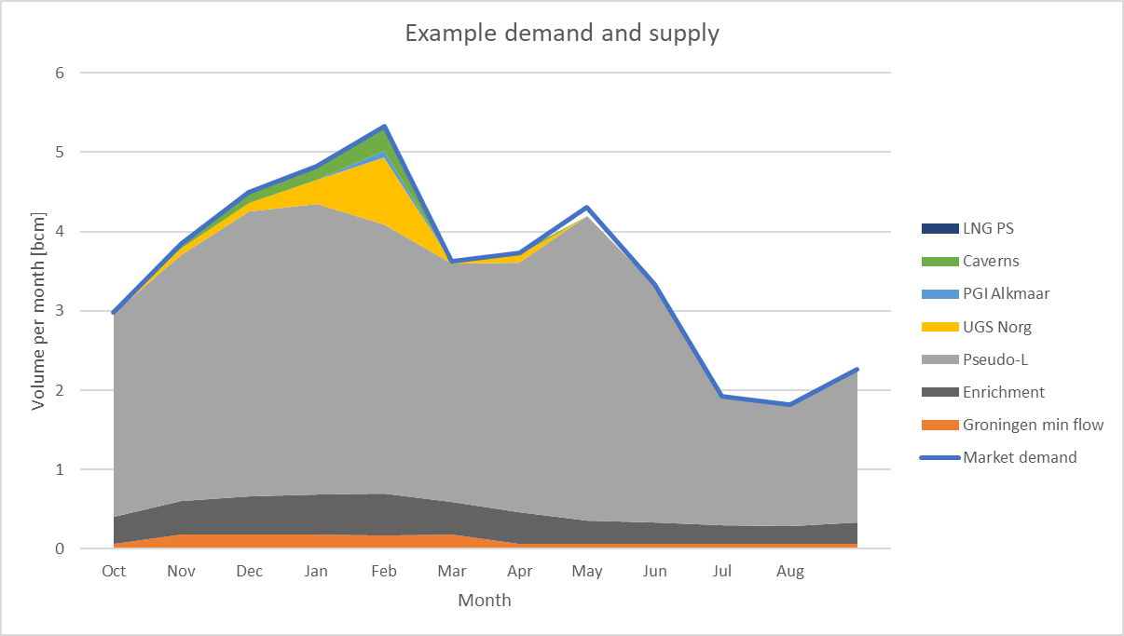
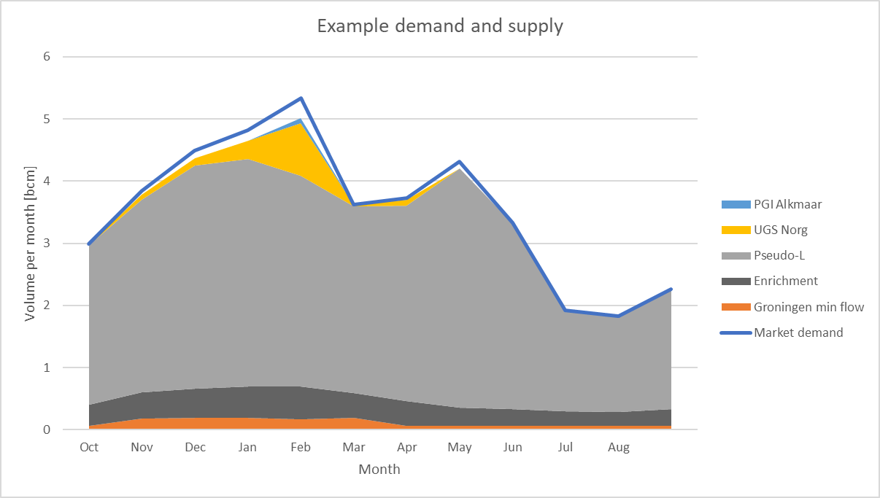
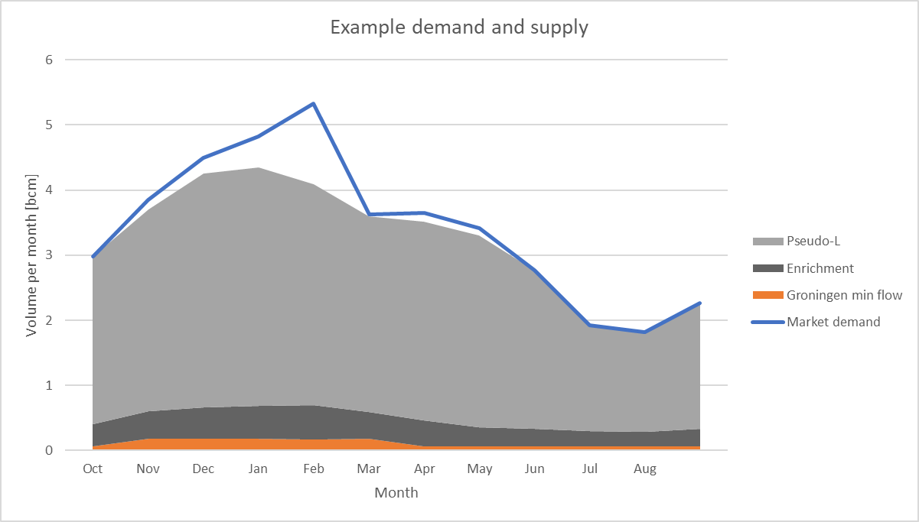
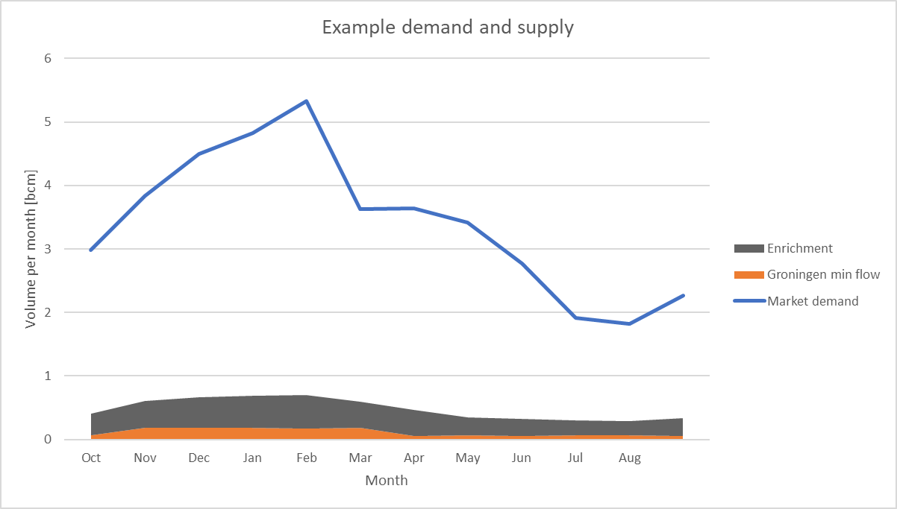
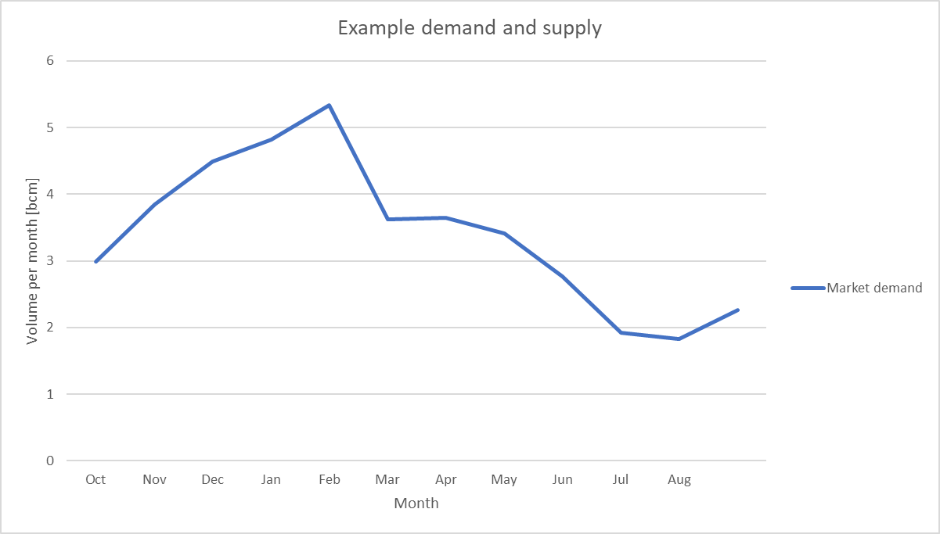
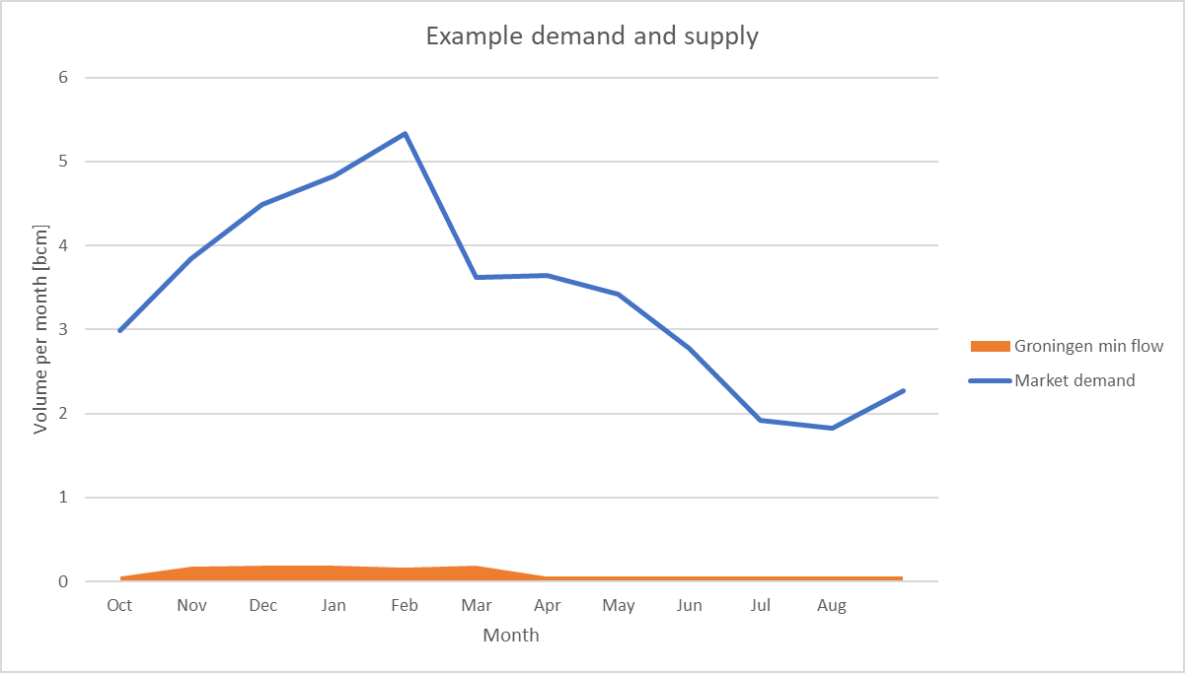
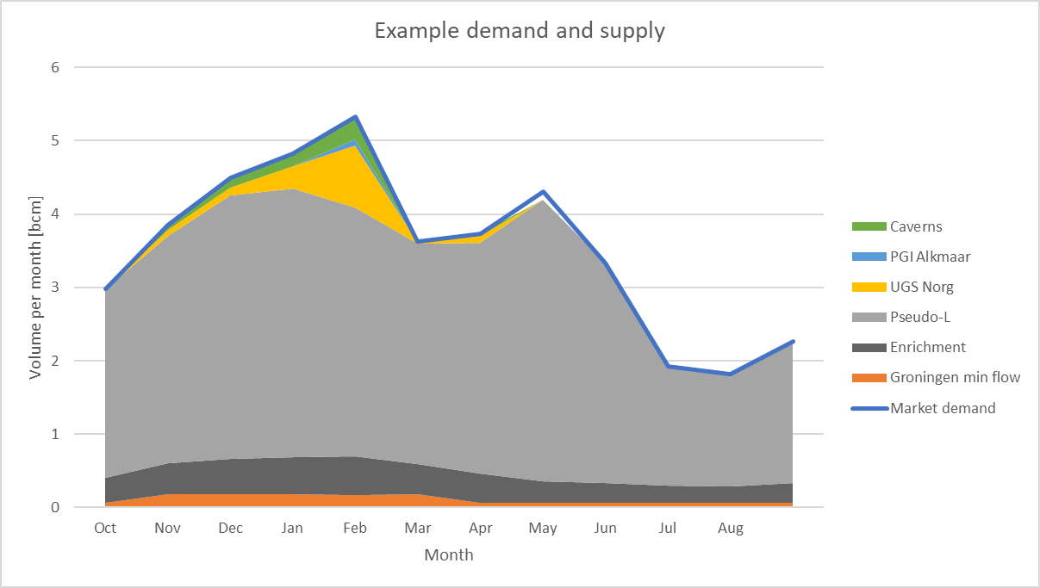
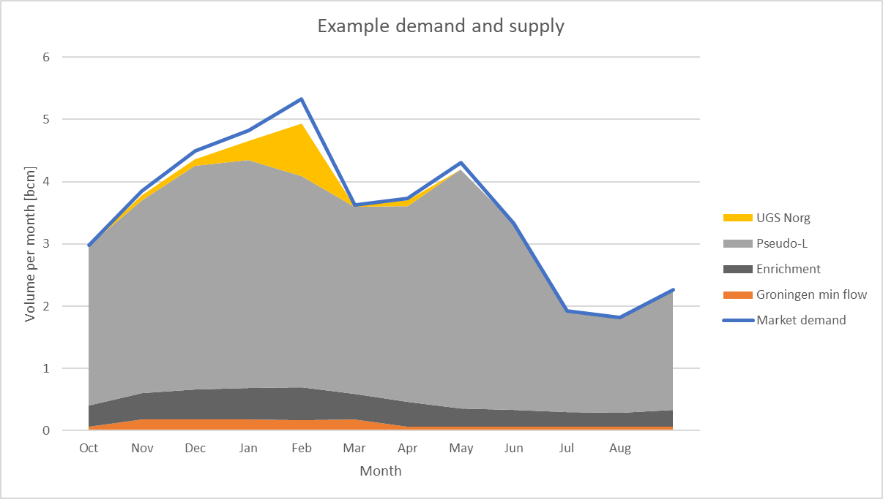
(Simplified) Modelling market demand and supply: volume

Slide 11
Modelling market demand and supply: capacity
Capacity Groningen
  Required Groningen capacity based on European regulation, to safeguard the security of gas supply (25 Oct 2017, 2017/1938), article 5 Infrastructure standard, clause 1
Assumption
  Single largest infrastructure (capacity) = UGS Norg
  Once in 20 years is translated to a daily average effective temperature of -15.5°C
Method
  Market capacity demand
  Determine the market capacity demand at a temperature of -15.5°C
  Market capacity supply
  Use all facilities (including back-up) at their technical capacity excluding UGS Norg
  Use Groningen to close the gap: that is the required Groningen production capacity
Market demand
Groningen
Peakshaver
Caverns
UGS Alkmaar
Conversion and enrichment
Supply

Slide 12
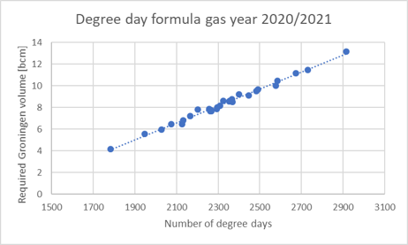
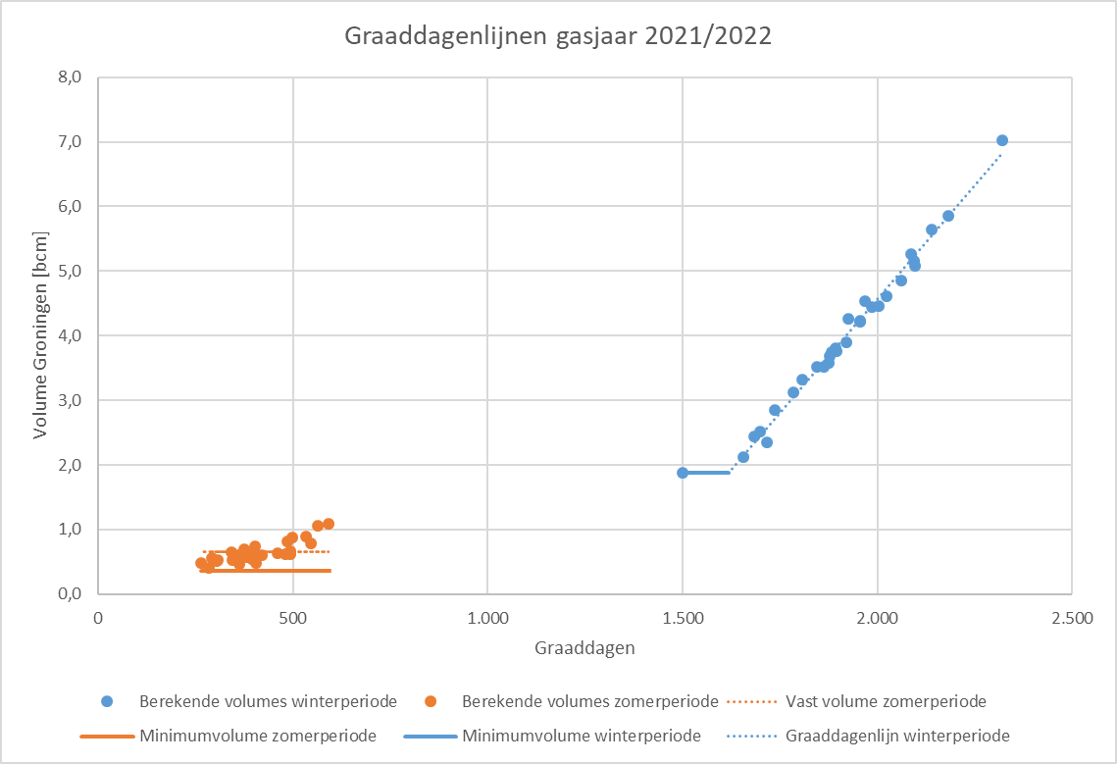
Groningen production on cold days
Last year GTS already changed the way of representing the so-called degree day formula
Part of phase I in Gas Act change “Wat na nul?”
Same modelling principles for determining demand and supply as in previous years, Groningen necessary in case of a potential gap

Slide 13
Groningen production in case of pseudo G-gas production limitations
So called back-up volume
Also foreseen change in the Gas Act with respect to the closure of Groningen (Wat na nul?)
In case pseudo G-gas production has limitations (for example nitrogen production below 100%, transport limitations, gas quality higher than expected), the market needs potentially extra Groningen volume
The conditions to produce back-up volume will be described in a so-called Ministerial Ruling
Back-up volume in the previous years: 1.5 bcm

Slide 14
Content
Legal framework
Evaluation gas year 2020/2021
Adjusted Gas Act and (recap) methodology
Planning assumptions for gas year 2022/2023
Consultation process
Changed assumptions for current gas year

Slide 15
L-gas Demand assumptions gas year 2022/2023
Realized hourly temperature profiles
  Last 30 temperature profiles at weather station de Bilt (KNMI)
  As required by the Dutch Gas Act: 1 October 1991 – 1 October 2021
  Modelled relation between temperature and demand
Domestic demand
  Klimaat- en Energieverkenning 2021
  Conversion of largest L-gas industries/power plants to H-gas based on the most recent conversion planning
L-gas demand in Germany, Belgium and France
  Market reduction based upon information supplied by MEAs of Germany, Belgium and France via Task Force L-gas Market Conversion Monitoring

Slide 16
L-gas Supply assumptions gas year 2022/2023
Planned nitrogen utilization set to 100% of base load nitrogen facilities, where the base load nitrogen facilities are:
  Ommen (cap. 146,000 m3/h N2)
  Wieringermeer (cap. 295,000 m3/h N2)
  Zuidbroek II (cap. 180,000 m3/h N2), assumptions are determined in consultation with MEZK
Blending station Pernis and Heiligerlee are considered as backup facilities, in order to guarantee the base load nitrogen capacity of 100%
There is sufficient H-gas available (small fields, import, LNG and storages) to feed the blending stations
Wobbe-index based on data provided by small field producers, import and LNG. Modelling not changed
Minimum flow production determined based on rules provided by EZK

Slide 17
L-gas Supply assumptions gas year 2022/2023
UGS Norg and UGS Alkmaar are available and volume neutral by definition
  Norg is filled with pseudo G-gas, working gas volume 4 bcm
Caverns are volume neutral by definition
  Base case: 2 caverns available (Energystock, and one of the three Epe caverns)
  All caverns available: one of the scenarios in sensitivity analysis​
Conversion of UGS Grijpskerk to L-gas
  assumptions are determined in consultation with MEZK
Peakshaver service available
Groningen is the balancing source in the merit order

Slide 18
Content
Legal framework
Evaluation gas year 2020/2021
Adjusted Gas Act and (recap) methodology
Planning assumptions for gas year 2022/2023
Consultation process
Changed assumptions for current gas year

Slide 19
Consultation process
We would like to ask your opinion/feedback on the planning assumptions
Consultation ends on 4 December 2021
Please send your written view to gasmarket@gastransport.nl
Your written views will be taken into account in our advice to the Minister of Economic Affairs and Climate Policy
  Letter will be sent before 1 February 2022

Slide 20
Content
Legal framework
Evaluation gas year 2020/2021
Adjusted Gas Act and (recap) methodology
Planning assumptions for gas year 2022/2023
Consultation process
Changed assumptions for current gas year

Slide 21
Changed assumptions for current gas year
Nitrogen facility Zuidbroek II:
  Three production units of each 60,000 m3/h N2
  Original planned delivery date: 1 April 2022
  Current planning
    Two units ready for production as of 1 July 2022
    Total facility ready by mid August 2022
UGS Norg: Send-out 5 bcm, 4 bcm injection
Injection possibilities of UGS Grijpskerk with pseudo G-gas to be decided
assumptions are determined in consultation with MEZK
Gas Act, Article 10a, paragraph 11: GTS reports a long-
  term and substantial deviation from the use of the
  means and methods or the demand for low-calorific gas compared to the estimate to the MEZK.

